Slide 1
Chapter Five
Database Recovery Techniques

Slide 2
Database Recovery
1. Purpose of Database Recovery
  To bring the database into the last consistent state, which existed prior to the failure.
  To preserve transaction properties (Atomicity, Consistency, Isolation and Durability).
Example:
  If the system crashes before a fund transfer transaction completes its execution, then either one or both accounts may have incorrect value. Thus, the database must be restored to the state before the transaction modified any of the accounts.
Therefore, recovery from transaction failures usually means that the database is restored to the most recent consistent state just before the time of failure.
Ayele G : Department of Computer Science
5/7/2019
Notes:
Ayele G. :Department of Computer Science

Slide 3
Database Recovery
2. Types of Failure
  The database may become unavailable for use due to
    Transaction failure: happens due to any logical error such as overflow of stack, bad input, data not found, less free space available etc., or by system error such as deadlocks etc.
    System failure: System may fail because of addressing error, application error, operating system fault, RAM failure, etc.
    Media failure: Disk head crash, power disruption, etc.
Ayele G : Department of Computer Science
5/7/2019
Notes:
Ayele G. :Department of Computer Science

Slide 4
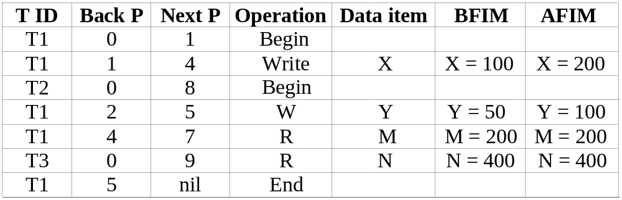
Database Recovery
3. Transaction Log
  For recovery from any type of failure data values prior to modification (BFIM - BeFore Image) and the new value after modification (AFIM – AFter Image) are required.
  These values and other information is stored in a sequential file called Transaction log. A sample log is given below. Back P and Next P point to the previous and next log records of the same transaction.
Ayele G : Department of Computer Science
5/7/2019
Notes:
the old value of the data item before updating is called the before image
(BFIM), and the new value after updating is called the after image (AFIM)
Ayele G. :Department of Computer Science

Slide 5
Database Recovery
4 Data Update
  Immediate Update: As soon as a data item is modified in cache, the disk copy is updated.
  Deferred Update: do not physically update the database on disk until after a transaction reaches its commit point.
  Shadow update: The modified version of a data item does not overwrite its disk copy but is written at a separate disk location.
  In-place update: The disk version of the data item is overwritten by the cache version.
Ayele G : Department of Computer Science
5/7/2019
Notes:
Ayele G. :Department of Computer Science

Slide 6
Database Recovery
5 Data Caching
  Data items to be modified are first stored into database cache by the Cache Manager (CM) and after modification they are flushed (written) to the disk.
  The flushing is controlled by Modified and Pin-Unpin bits.
    Pin-Unpin: Instructs the operating system not to flush the data item.
    Modified: Indicates the AFIM of the data item.
Ayele G : Department of Computer Science
5/7/2019
Notes:
Ayele G. :Department of Computer Science

Slide 7
Database Recovery
6 Transaction Roll-back (Undo) and Roll-Forward (Redo)
  To maintain atomicity, a transaction’s operations are redone or undone.
    Undo: Restore all BFIMs on to disk (Remove all AFIMs)
    Redo: Restore all AFIMs on to disk.
  Database recovery is achieved either by performing only Undos or only Redos or by a combination of the two.
    These operations are recorded in the log as they happen.
Ayele G : Department of Computer Science
5/7/2019
Notes:
Ayele G. :Department of Computer Science

Slide 8
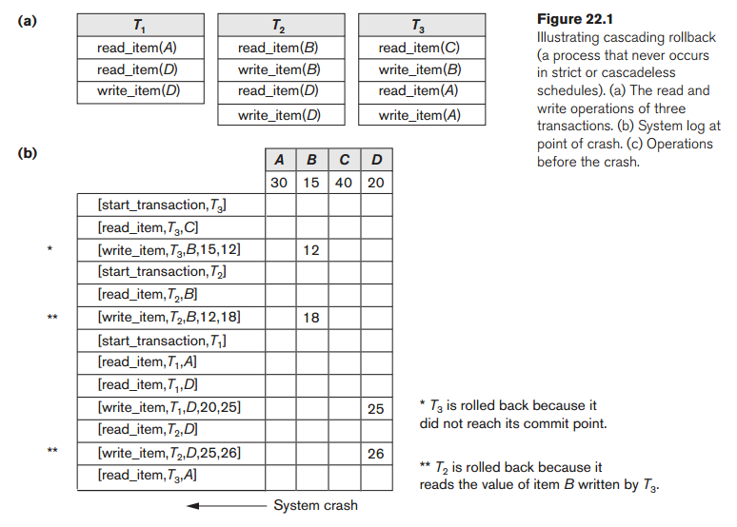
Database Recovery
Ayele G : Department of Computer Science
5/7/2019
Notes:
Ayele G. :Department of Computer Science

Slide 9
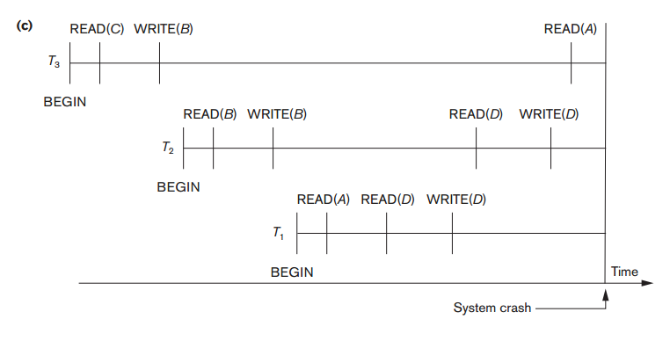
Database Recovery
Roll-back: One execution of T1, T2 and T3 as recorded in the log.
Ayele G : Department of Computer Science
5/7/2019
Notes:
Ayele G. :Department of Computer Science

Slide 10
Database Recovery
We must now check for cascading rollback.
From Figure 22.1(c), we see that transaction T2 reads the value of item B that was written by transaction T3; this can also
be determined by examining the log.
  Because T3 is rolled back, T2 must now be rolled back, too.
  The WRITE operations of T2, marked by ** in the log, are the ones
  that are undone.
  Note that only write_item operations need to be undone during
  transaction rollback; read_item operations are recorded in the log only to determine whether cascading rollback of additional transactions is necessary.
Ayele G : Department of Computer Science
5/7/2019
Notes:
Ayele G. :Department of Computer Science

Slide 11
Database Recovery
Write-Ahead Logging
When immediate or deferred update is used then log is necessary for recovery and it must be available to recovery manager.
This is achieved by Write-Ahead Logging (WAL) protocol.
WAL states that:
  For Undo: Before a data item’s AFIM is flushed to the database disk (overwriting the BFIM) its BFIM must be written to the log and the log must be saved on a stable store (log disk).
  For Redo: Before a transaction executes its commit operation, all its AFIMs must be written to the log and the log must be saved on a stable store
Ayele G : Department of Computer Science
5/7/2019
Notes:
Ayele G. :Department of Computer Science

Slide 12
Database Recovery
7 Checkpointing
  Time to time (randomly or under some criteria) the database flushes its buffer to database disk to minimize the task of recovery.
  The following steps defines a checkpoint operation:
      Suspend execution of transactions temporarily
      Force write modified buffer data to disk
      Write a [checkpoint] record to the log, save the log to disk
      Resume normal transaction execution
Checkpoint declares a point before which the DBMS was in consistent state, and all the transactions were committed.
Advantages of check points are
  No need to redo successfully completed transactions before most recent checkpoints
  Less searching required
Ayele G : Department of Computer Science
5/7/2019
Notes:
Checkpoint declares a point before which the DBMS was in consistent state, and all the transactions were committed.
Ayele G. :Department of Computer Science

Slide 13
Database Recovery
Steal/No-Steal and Force/No-Force
  Possible ways for flushing database cache to database disk:
    Steal: Cache can be flushed before transaction commits.
    No-Steal: Cache cannot be flushed before transaction commit.
    Force: Cache is immediately flushed (forced) to disk
    No-Force: Cache is deferred until transaction commits
Ayele G : Department of Computer Science
5/7/2019
Notes:
Ayele G. :Department of Computer Science

Slide 14
Database Recovery
8. Recovery Scheme
Deferred Update (No Undo/Redo)
  The idea behind deferred update is to defer or postpone any actual updates to the database on disk until the transaction completes its execution successfully and reaches its commit point
The data update goes as follows:
  A set of transactions records their updates in the log.
  At commit point under WAL scheme these updates are saved on database disk.
  After reboot from a failure the log is used to redo all the transactions affected by this failure. No undo is required because no AFIM is flushed to the disk before a transaction commits.
Ayele G : Department of Computer Science
5/7/2019
Notes:
Ayele G. :Department of Computer Science

Slide 15
Database Recovery
Deferred Update in a single-user system
There is no concurrent data sharing in a single user system.
The data update goes as follows:
  A set of transactions records their updates in the log.
  At commit point under WAL scheme these updates are saved on database disk.
  After reboot from a failure the log is used to redo all the transactions affected by this failure.
  No undo is required because no AFIM is flushed to the disk before a transaction commits.
Ayele G : Department of Computer Science
5/7/2019
Notes:
Ayele G. :Department of Computer Science

Slide 16
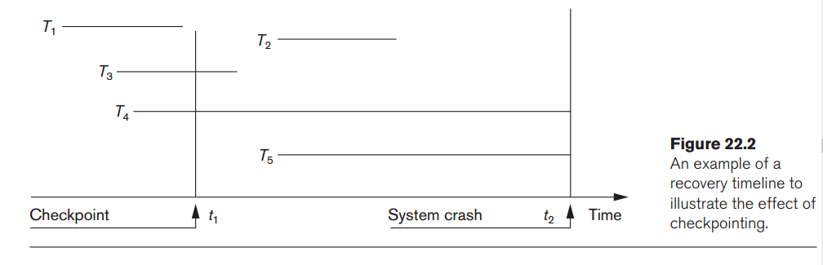
Database Recovery
Deferred Update with Concurrent Users
This environment requires some concurrency control mechanism to guarantee isolation property of transactions. In a system recovery transactions which were recorded in the log after the last checkpoint were redone. The recovery manager may scan some of the transactions recorded before the checkpoint to get the AFIMs
Ayele G : Department of Computer Science
5/7/2019
Notes:
The write_item operations of T
must be
redone, however, because both transactions reached their commit points after the
last checkpoint. Recall that the log is force-written before committing a transaction.
Transactions T
4
and T
5
2
are ignored: They are effectively canceled or rolled back
because none of their
write_item operations were recorded in the database on disk
under the deferred update protocol.
Ayele G. :Department of Computer Science

Slide 17
Database Recovery
Deferred Update with Concurrent Users
Figure 22.2 illustrates a timeline for a possible schedule of executing transactions.
When the checkpoint was taken at time t1, transaction T1 had committed, whereas transactions T3 and T4 had not.
Before the system crash at time t2, T3 and T2 were committed but not T4 and T5.
According to the RDU_M(No-Undo/Redo with checkpoints) method, there is no need to redo the write_item operations of transaction T1-or any transactions committed before the last checkpoint time t1.
The write_item operations of T2 and T3 must be redone, however, because both transactions reached their commit points after the last checkpoint.
Recall that the log is force-written before committing a transaction. Transactions T4 and T5 are ignored: They are effectively canceled or rolled back because none of their write_item operations were recorded in the database on disk under the deferred update protocol (no-steal policy).
Ayele G : Department of Computer Science
5/7/2019
Notes:
The write_item operations of T
must be
redone, however, because both transactions reached their commit points after the
last checkpoint. Recall that the log is force-written before committing a transaction.
Transactions T
4
and T
5
2
are ignored: They are effectively canceled or rolled back
because none of their
write_item operations were recorded in the database on disk
under the deferred update protocol.
Ayele G. :Department of Computer Science

Slide 18
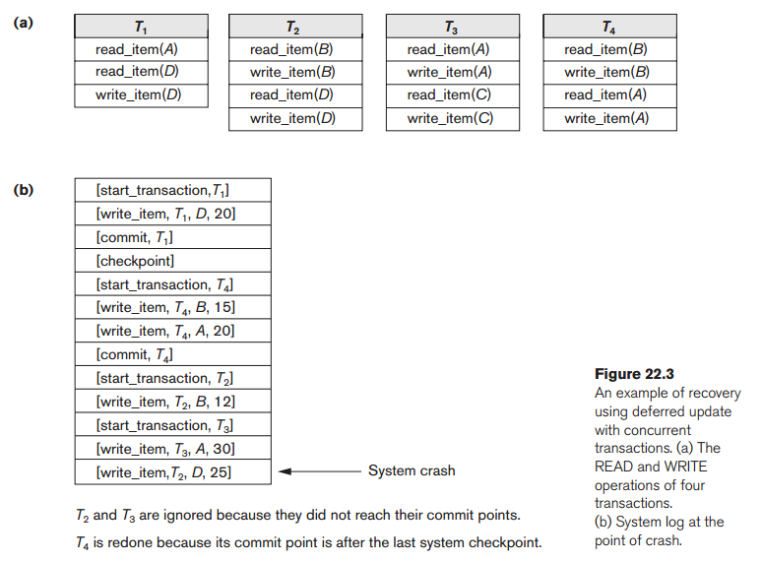
Database Recovery
Deferred Update with Concurrent Users
Example of recovery for a multiuser system that utilizes the
recovery and concurrency control method just described.
Ayele G : Department of Computer Science
5/7/2019
Notes:
The write_item operations of T
must be
redone, however, because both transactions reached their commit points after the
last checkpoint. Recall that the log is force-written before committing a transaction.
Transactions T
4
and T
5
2
are ignored: They are effectively canceled or rolled back
because none of their
write_item operations were recorded in the database on disk
under the deferred update protocol.
Ayele G. :Department of Computer Science

Slide 19
Database Recovery
Deferred Update with Concurrent Users
Two tables are required for implementing this protocol:
  Active table: All active transactions are entered in this table.
  Commit table: Transactions to be committed are entered in this table.
During recovery, all transactions of the commit table are redone and all transactions of active tables are ignored and resubmitted since none of their AFIMs reached the database.
It is possible that a commit table transaction may be redone twice but this does not create any inconsistency because of a redone is “idempotent”.
  i.e one redone for an AFIM is equivalent to multiple redone for the same AFIM.
Ayele G : Department of Computer Science
5/7/2019
Notes:
Ayele G. :Department of Computer Science

Slide 20
Database Recovery
Recovery Techniques Based on Immediate Update
When a transaction issues an update command:
  The database on disk can be updated immediately, without any need to wait for the transaction to reach its commit point
  Notice that it is not a requirement that every update be applied immediately to disk
It is just possible that some updates are applied to disk before the transaction commits.
Undo/No-redo Algorithm
  In this algorithm AFIMs of a transaction are flushed to the database disk under WAL before the transaction commits.
  For this reason the recovery manager undo all transactions during recovery.
  No transaction is redo.
  It is possible that a transaction might have completed execution and ready to commit but this transaction is also undone.
What if the transaction is allowed to commit before all its changes are written to the database ?---on the next Two slides
Ayele G : Department of Computer Science
5/7/2019
Notes:
Ayele G. :Department of Computer Science

Slide 21
Database Recovery
Recovery Techniques Based on Immediate Update
  Undo/Redo Algorithm (Single-user environment)---
    Recovery schemes of this category apply undo and also redo for recovery.
    In a single-user environment no concurrency control is required but a log is maintained under WAL.
    Note that at any time there will be one transaction in the system and it will be either in the commit table or in the active table.
    The recovery manager performs:
      Undo of a transaction if it is in the active table.
      Redo of a transaction if it is in the commit table.
Ayele G : Department of Computer Science
5/7/2019
Notes:
Ayele G. :Department of Computer Science

Slide 22
Database Recovery
Recovery Techniques Based on Immediate Update
Undo/Redo Algorithm (Concurrent execution)
Recovery schemes of this category applies undo and also redo to recover the database from failure.
In concurrent execution environment a concurrency control is required and log is maintained under WAL.
Commit table records transactions to be committed and active table records active transactions. To minimize the work of the recovery manager checkpointing is used.
The recovery performs:
  Undo of a transaction if it is in the active table.
  Redo of a transaction if it is in the commit table.
Ayele G : Department of Computer Science
5/7/2019
Notes:
Ayele G. :Department of Computer Science

Slide 23
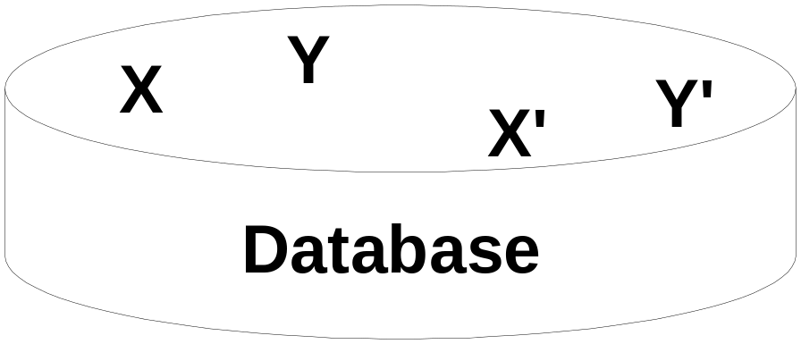
Database Recovery
Shadow Paging
The AFIM does not overwrite its BFIM but recorded at another place on the disk.
Thus, at any time a data item has AFIM and BFIM (Shadow copy of the data item) at two different places on the disk.
X and Y: Shadow copies of data items
X' and Y': Current copies of data items
Ayele G : Department of Computer Science
5/7/2019
Notes:
Ayele G. :Department of Computer Science

Slide 24
Database Recovery
Shadow Paging
A directory with n entries is constructed, where the i^{th} entry points to the i^{th} database page on disk.
The directory is kept in main memory if it is not too large, and all references-reads or writes-to database pages on disk go through it.
When a transaction begins executing, the current director-whose entries point to the most recent or current database pages on disk-is copied into a shadow directory
  The shadow directory is then saved on disk while the current directory is used by the transaction
Ayele G : Department of Computer Science
5/7/2019
Notes:
Ayele G. :Department of Computer Science

Slide 25
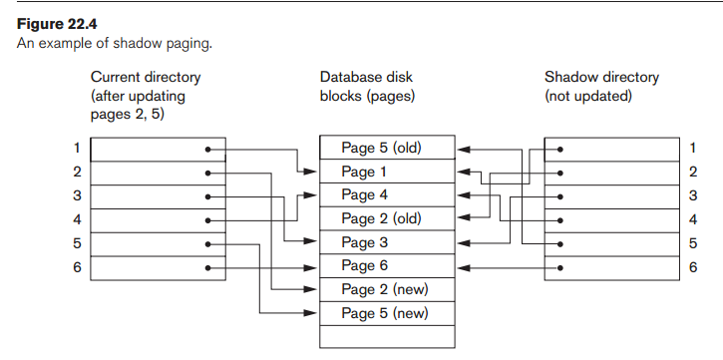
Database Recovery
Shadow Paging
To manage access of data items by concurrent transactions two directories (current and shadow) are used.
  The directory arrangement is illustrated below. Here a page is a data item.
5/7/2019
Ayele G : Department of Computer Science
Notes:
Ayele G. :Department of Computer Science

Slide 26
Database Recovery
The ARIES Recovery Algorithm(Algorithms for Recovery and Isolation Exploiting Semantics)
ARIES Recovery Algorithm is based on:
  WAL (Write Ahead Logging)
  Repeating history during redo:
    ARIES will retrace all actions of the database system prior to the crash to reconstruct the database state when the crash occurred
  Logging during undo:
    It will prevent ARIES from repeating the completed undo operations if a failure occurs during recovery, which causes a restart of the recovery process
Ayele G : Department of Computer Science
5/7/2019
Notes:
Algorithms for Recovery and Isolation Exploiting Semantics
Ayele G. :Department of Computer Science

Slide 27
Database Recovery
The ARIES Recovery Algorithm
ARIES recovery algorithm consists of three steps:
  Analysis: step identifies the dirty (updated) pages in the buffer and the set of transactions active at the time of crash. The appropriate point in the log where redo is to start is also determined.
  Redo: Necessary redo operations are applied.
  Undo: log is scanned backwards and the operations of transactions active at the time of crash are undone in reverse order.
Ayele G : Department of Computer Science
5/7/2019
Notes:
Ayele G. :Department of Computer Science

Slide 28
Database Recovery
The ARIES Recovery Algorithm
The information needed for ARIES to accomplish its recovery procedure includes
  The log
  The Transaction Table, and
  The Dirty Page Table
  Additionally, checkpointing is used. These tables are maintained by the transaction manager and written to the log during checkpointing
Ayele G : Department of Computer Science
5/7/2019
Notes:
Ayele G. :Department of Computer Science

Slide 29
Database Recovery
The ARIES Recovery Algorithm
The Log and Log Sequence Number (LSN)
Every log record has an associated log sequence number (LSN) that is monotonically increasing and indicates the address of the log record on disk.
Each LSN corresponds to a specific change (action) of some transaction
Each data page will store the LSN of the latest log record corresponding to a change for that page
A log record is written for any of the following actions:
    data update
    transaction commit
    transaction abort
    undo
    transaction end
  In the case of undo a compensating log record is written in the log so that the undo does not have to be repeated
Ayele G : Department of Computer Science
5/7/2019
Notes:
When a transaction ends, whether by committing or aborting, an end log record is written.
Ayele G. :Department of Computer Science

Slide 30
Database Recovery
The ARIES Recovery Algorithm
The Log and Log Sequence Number (LSN) (cont.)
A log record stores:
  Previous LSN of that transaction: It links the log record of each transaction. It is like a back pointer points to the previous record of the same transaction
  Transaction ID
  Type of log record
For a write operation the following additional information is logged:
  Page ID for the page that includes the item
  Length of the updated item
  Its offset from the beginning of the page
  BFIM of the item
  AFIM of the item
Ayele G : Department of Computer Science
5/7/2019
Notes:
Ayele G. :Department of Computer Science

Slide 31
Database Recovery
The ARIES Recovery Algorithm
Besides the log, two tables are needed for efficient recovery:
Transaction table and Dirty Page table
    Transaction Table: Contains an entry for each active transaction, with information such as transaction ID, transaction status and the LSN of the most recent log record for the transaction
    Dirty Page Table: Contains an entry for each dirty page in the buffer, which includes the page ID and the LSN corresponding to the earliest update to that page
Ayele G : Department of Computer Science
5/7/2019
Notes:
Ayele G. :Department of Computer Science

Slide 32
Database Recovery
The ARIES Recovery Algorithm
Checkpointing
  A checkpointing does the following:
    Writes a begin_checkpoint record in the log
    Writes an end_checkpoint record in the log. With this record the contents of transaction table and dirty page table are appended to the end of the log
    Writes the LSN of the begin_checkpoint record to a special file. This special file is accessed during recovery to locate the last checkpoint information
  To reduce the cost of checkpointing and allow the system to continue to execute transactions, ARIES uses “fuzzy checkpointing”. So that the DBMS can continue to execute transactions during checkpointing
Ayele G : Department of Computer Science
5/7/2019
Notes:
Ayele G. :Department of Computer Science

Slide 33
Database Recovery
10 Recovery in Multi-database System
A multi-database system is a special distributed database system where one node may be running relational database system under UNIX, another may be running object-oriented system under Windows and so on.
A transaction may run in a distributed fashion at multiple nodes.
In this execution scenario the transaction commits only when all these multiple nodes agree to commit individually the part of the transaction they were executing
This commit scheme is referred to as “two-phase commit” (2PC)
  If any one of these nodes fails or cannot commit the part of the transaction, then the transaction is aborted
Each node recovers the transaction under its own recovery protocol
Ayele G : Department of Computer Science
5/7/2019
Notes:
Ayele G. :Department of Computer Science

Slide 34
Database Recovery
Summary
  Types of Failure
  Transaction Log
  Data Updates
  Data Caching
  Transaction Roll-back (Undo) and Roll-Forward
  Check-pointing
  The ARIES Recovery Algorithm
  Recovery in Multi-database System
Ayele G : Department of Computer Science
5/7/2019
Notes:
Ayele G. :Department of Computer Science

Slide 35
?

